Slide 1
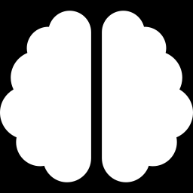
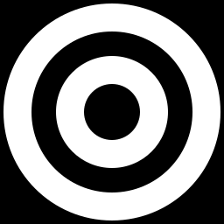
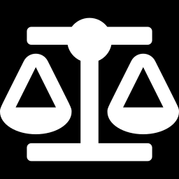
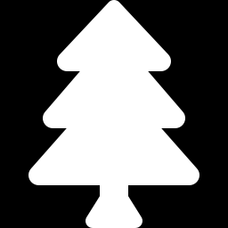
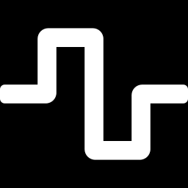
MACHINE LEARNING
Supervised Learning Models
Mathematics, Formulas & Term-by-Term Explanations
K-Nearest
Neighbors
Naive Bayes
Random Forest
Logistic
Regression

Slide 2
ROADMAP
What We'll Cover
K-Nearest Neighbors
Naive Bayes
Random Forest
Logistic Regression
Classifies a point based on the majority vote of its k closest neighbors.
Applies Bayes' Theorem, assuming features are independent given the class.
Combines many decision trees trained on random subsets and averages their votes.
Models the log-odds of an outcome as a linear function, then converts it to a probability.

Slide 3
MODEL 1
K-Nearest Neighbors (KNN)
Stores the entire training dataset — there is no explicit 'training' phase.
To predict a new point, it finds the k closest training points using a distance metric.
For classification, it takes a majority vote among those k neighbors.
For regression, it averages the values of the k neighbors.
Choice of k and the distance metric strongly affect performance.
Classification & Regression
(instance-based / “lazy” learner)

Slide 4
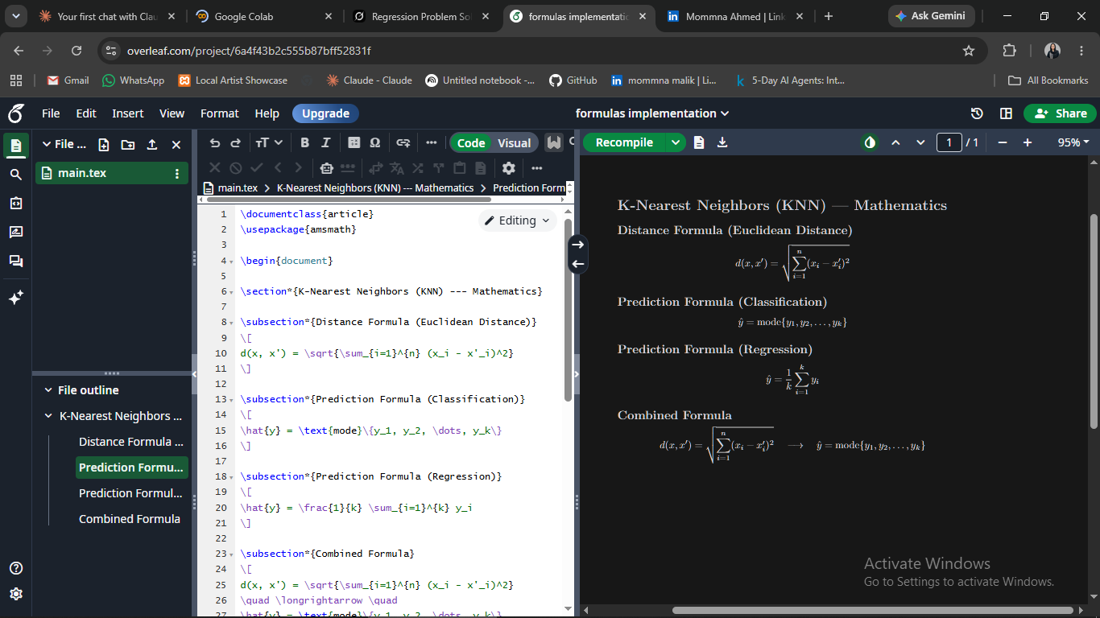
K-Nearest Neighbors
Symbol | Meaning
d(x, x′) | Euclidean distance between a new point x and a training point x′.
xᵢ, x′ᵢ | The i-th feature values of the two points being compared.
k | Number of nearest neighbors considered for the prediction.
ŷ (y-hat) | Predicted label — the most common class among the k neighbors.
mode{...} | The most frequently occurring value in the neighbor set (majority vote).
MATHEMATICS & FORMULA
CHOOSING K
Small k → sensitive to noise (overfitting)
Large k → smoother but may blur class boundaries
k is usually chosen via cross-validation
Features are often scaled first so no single feature dominates the distance.

Slide 5
MODEL 2
Naive Bayes
Based on Bayes' Theorem — it calculates the probability of each class given the input features.
'Naive' because it assumes all features are independent of each other given the class.
Despite this simplifying assumption, it performs very well in practice (e.g. spam filtering, text classification).
Fast to train since it only needs to estimate simple probabilities from the data.
Classification
(probabilistic model)

Slide 6
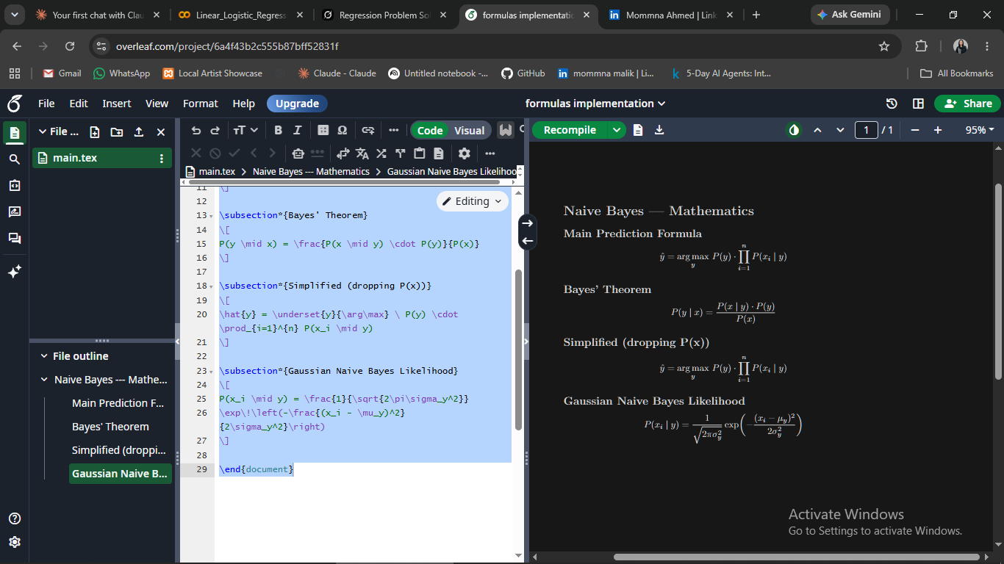
Naive Bayes
Symbol | Meaning
ŷ (y-hat) | Predicted class — the one with the highest resulting probability.
argmaxᵧ | Chooses the class y that maximizes the expression that follows.
P(y) | Prior probability — how common class y is in the training data.
P(xᵢ | y) | Likelihood — probability of observing feature xᵢ given class y.
∏ (product) | Multiplies the likelihoods of all features together (independence assumption).
MATHEMATICS & FORMULA
BAYES' THEOREM
P(y|x) = P(x|y)·P(y) / P(x)
P(x) is the same for every class, so it can be dropped when comparing classes
Common variants: Gaussian, Multinomial, Bernoulli Naive Bayes

Slide 7
MODEL 3
Random Forest
An ensemble method — it builds many decision trees and combines their outputs.
Each tree is trained on a random bootstrap sample of the data (bagging).
Each split also considers only a random subset of features, making trees less correlated.
Final prediction: majority vote (classification) or average (regression) across all trees.
Reduces overfitting compared to a single decision tree.
Classification & Regression
(ensemble of Decision Trees)

Slide 8
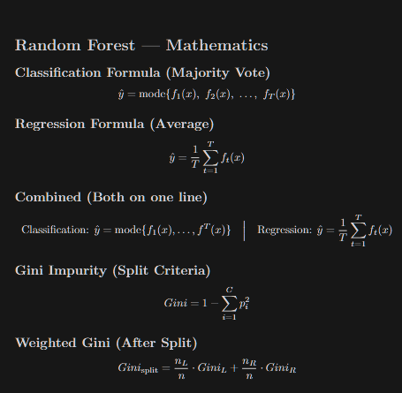
Symbol | Meaning
T | Total number of decision trees in the forest.
fₜ(x) | Prediction made by the t-th individual tree for input x.
mode{...} | Majority class vote across all T trees (classification).
(1/T) Σ fₜ(x) | Average of all tree predictions (regression).
Bagging | Bootstrap Aggregating — training each tree on a random resampled subset.
Random Forest
MATHEMATICS & FORMULA
WHY IT WORKS
Individual trees may overfit and be noisy
Averaging many diverse trees cancels out individual errors
Randomness in samples + features keeps trees decorrelated
Generally more accurate and stable than a single tree.

Slide 9
MODEL 4
Logistic Regression
Used when the output is a category, most commonly a yes/no or 0/1 outcome.
Instead of predicting y directly, it models the log-odds of the outcome as a linear function of the inputs.
The predicted log-odds is converted back into a probability between 0 and 1.
Each coefficient tells you how the odds of the outcome change as that feature increases.
Coefficients are estimated using Maximum Likelihood Estimation (MLE), not least squares.
Classification
(binary outcome: 0 or 1)

Slide 10
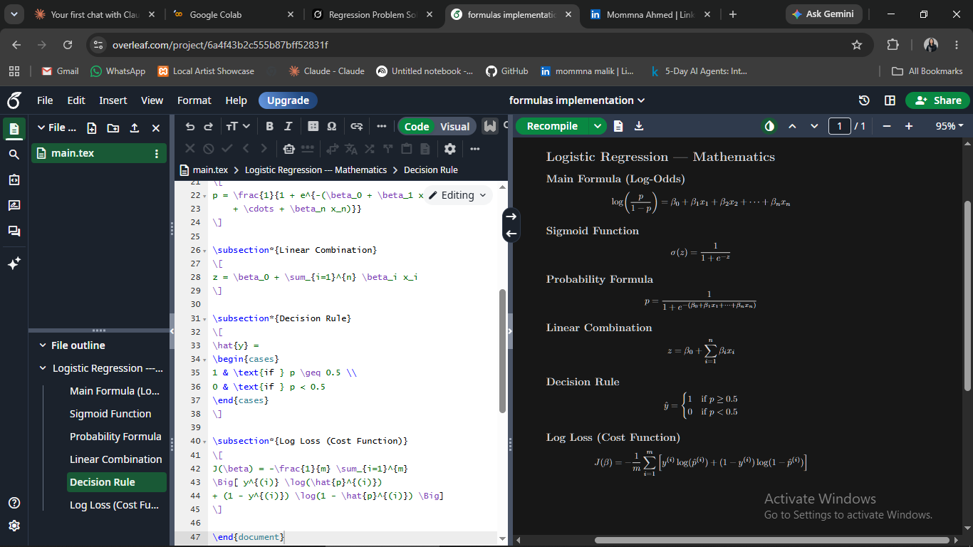
Logistic Regression
MATHEMATICS & FORMULA
Symbol | Meaning
log(p/(1−p)) | Logit — the log-odds of the outcome belonging to class 1.
p | Predicted probability that the outcome is class 1.
β₀ | Intercept — baseline log-odds when all features are zero.
βᵢ | Change in log-odds for a one-unit increase in feature xᵢ.
xᵢ | Input feature values used to predict the outcome.
READING THE RESULT
p ≥ 0.5 ↔ log-odds ≥ 0 → predict class 1
exp(βᵢ) = odds ratio for feature xᵢ
Estimated by Maximum Likelihood Estimation (MLE)
L1/L2 regularization is often added to prevent overfitting.

